Slide 1
Chapter 3 – Bernoulli’s Equation
CE30460 - Fluid Mechanics
Diogo Bolster

Slide 2
Newton’s Second Law
F=ma
What does this mean for a fluid? (inviscid)
First we need to understand streamline:
If a flow is steady a streamline depicts the path a fluid particle will take through the flow. They are tangent to the velocity vectors
http://www.youtube.com/watch?v=j6yB90vno1E&feature=related
http://www.youtube.com/watch?v=rbMx2NMqyuI&feature=related
http://www.youtube.com/watch?v=0xsC-UVFjps&NR=1
The are between two streamlines is called a streamtube

Slide 3
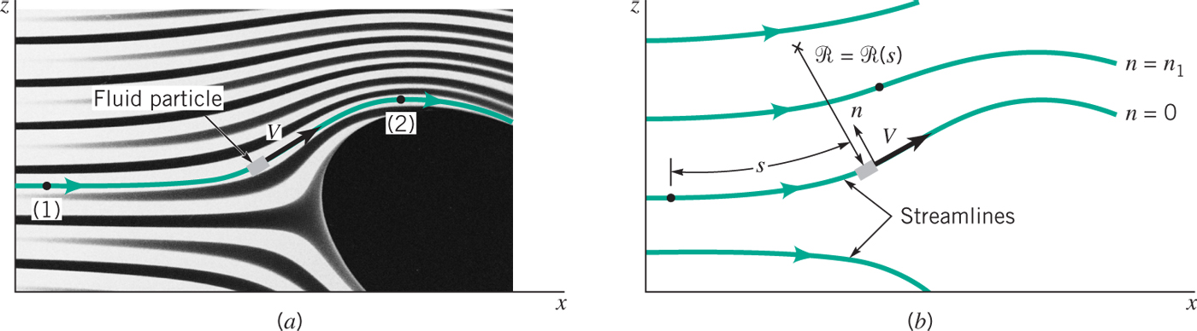
Streamlines
We can calculate acceleration along an normal to a streamline
Note – particles travel along a streamlines, but that does not mean a constant velocity
Two components
Along the streamline
Normal to streamline

Slide 4
Streamlines
We can calculate acceleration along an normal to a streamline
Note – particles travel along a streamlines, but that does not mean a constant velocity
Two components
Along the streamline
Normal to streamline (centrifugal)
a_{s}=dV/dt=(δV/δs)(ds/dt)=(δV/δs)V
a_{n}=V²/R
R is the local radius of curvature

Slide 5
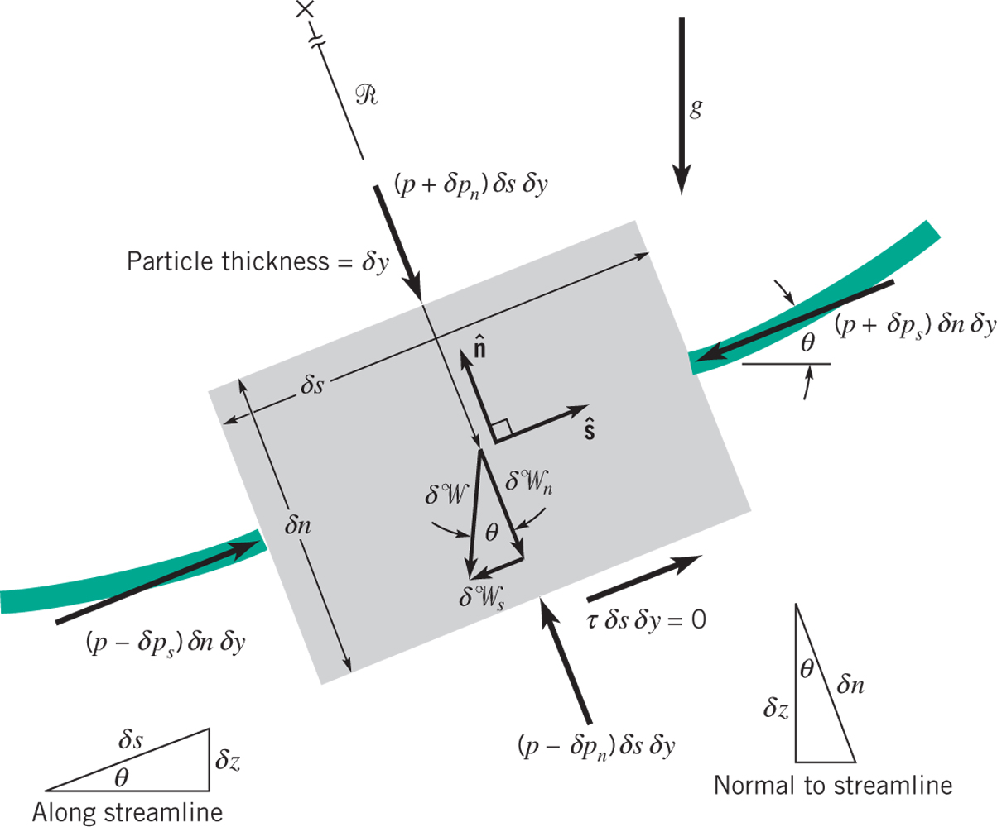

Newton’s Second Law along a streamline
F=ma – apply it to the small control volume depicted here (along a streamline!!)

Slide 6


The Bernoulli Equation
Newton’s second law for an inviscid fluid is called the Bernoulli equation. It is technically a momentum equation, but often refers to energy…
Pressure Acceleration Gravity
Integrate assuming constant density and we obtain

Slide 7

Normal to a Streamline?
Go back and do the balance

Slide 8
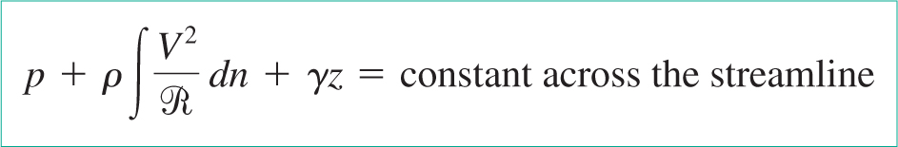
Normal to a Streamline?

Slide 9
Sample Problem 1
What pressure gradient along a streamline, dp/ds, is required to accelerate water upward in a vertical pipe at a rate of 10 m/s²? What is the answer if the flow is downwards?

Slide 10
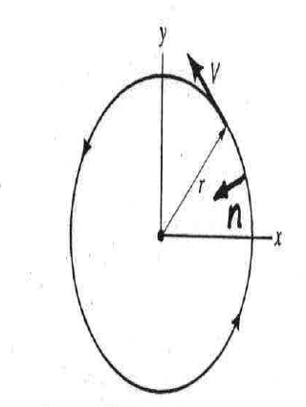
Sample Problem 2
Consider a tornado. The streamlines are circles of radius r and speed V. Determine pressure gradient dp/dr for
(a) water r=10cm in and V=0.2 m/s
(b) air r=100 m and V=200 km/h

Slide 11
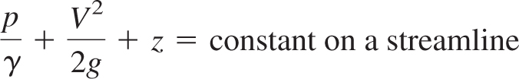
Back to Bernoulli Equation
A very important equation
The above version is called the energy representation
But what does it actually mean? Let’s rewrite it a little

Slide 12
Physical Interpretation
Each of these terms represents a potential that the fluid has and that can freely be exchanged along a streamline, e.g. if velocity decreases either the pressure head of elevation head must increase
Pressure
Head
Elevation
Head
Velocity
Head

Slide 13
Static, Dynamic and Hydrostatic Pressure
Static Pressure
The pressure one feels if static relative to the flow (i.e. moving with the flow). This is the pressure in the Bernoulli equation
p
Dynamic Pressure
The pressure exerted by the velocity field – i.e. associated with the second term in Bernoulli equation
ρV²/2
Hydrostatic Pressure
The pressure from the third term in Bernoulli
γz

Slide 14
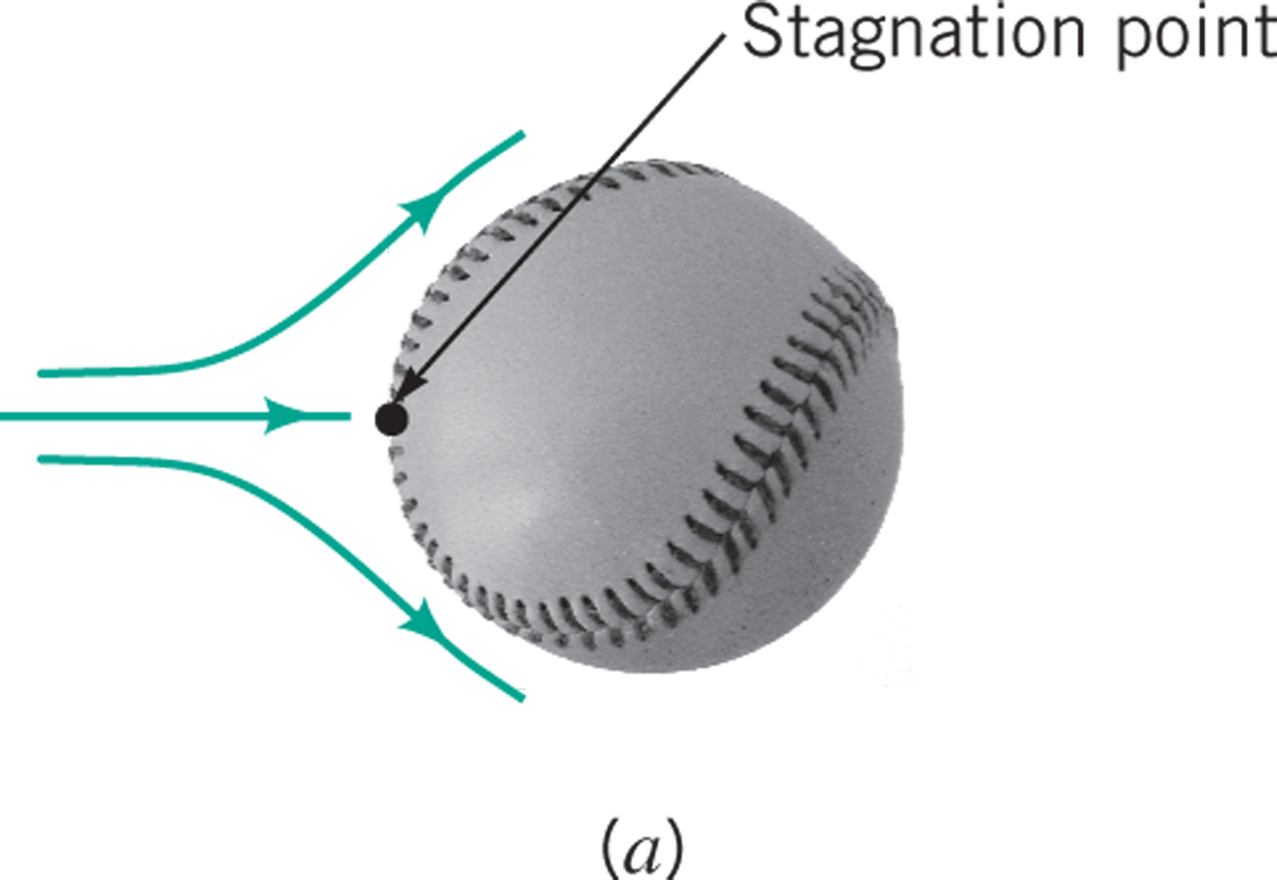
Stagnation Pressure
Stagnation Point
Consider the situation where z=const (e.g. baseball to right).
Consider a frame of reference where fluid moves and baseball stationary (relative velocity)
Point 1 is far from the ball
Point 2 is on the ball surface and the same streamline as 1.
The pressure at a stagnation point is called : Stagnation Pressure.
1
2

Slide 15
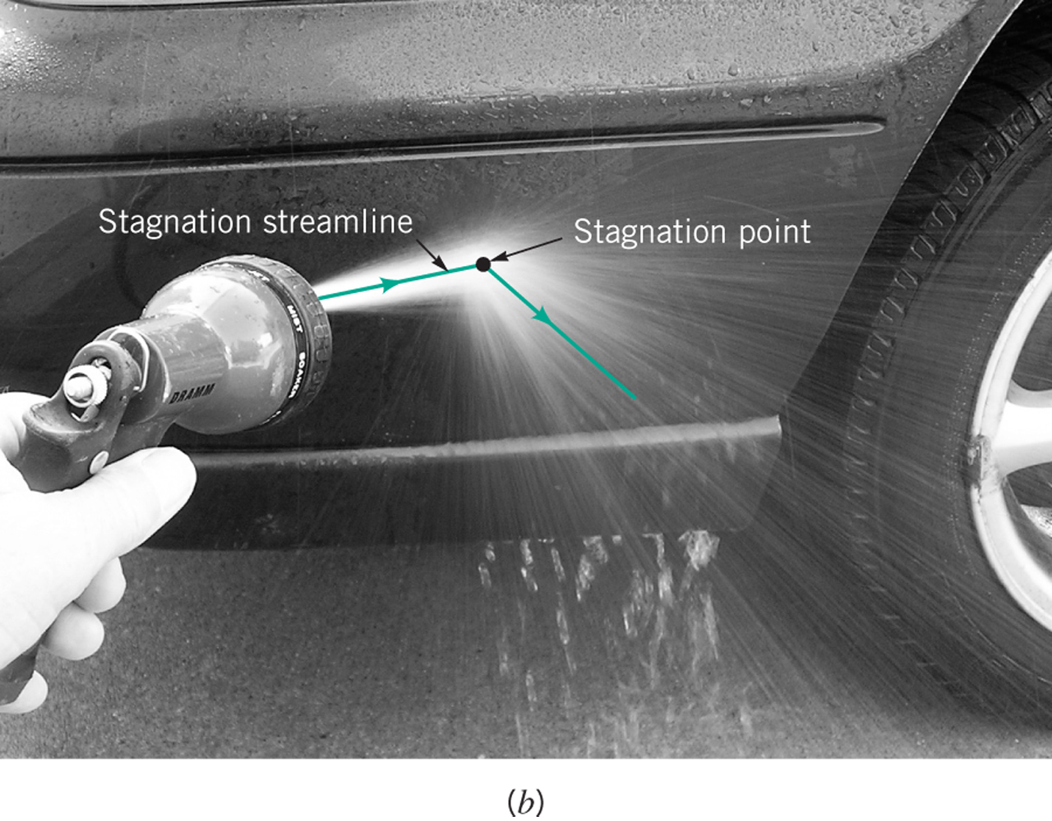
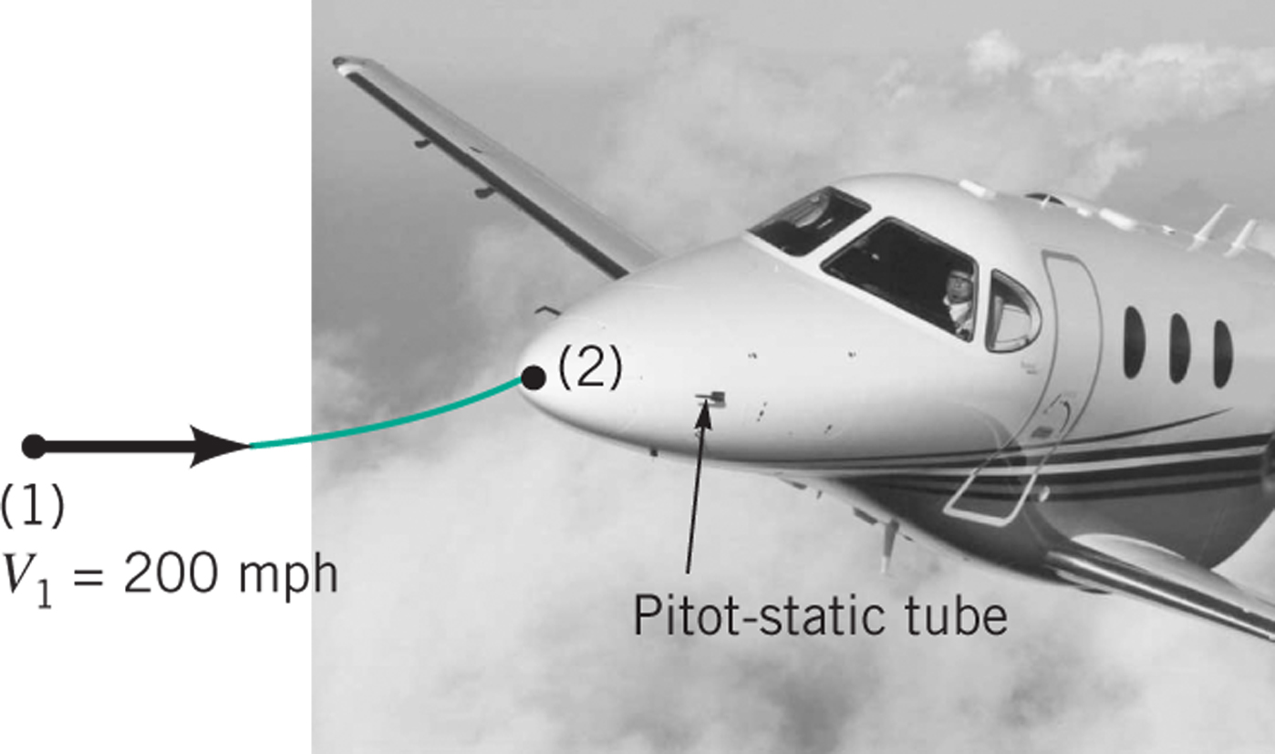
Total Pressure
In analogy to the stagnation pressure we can define a total pressure (i.e. if you convert all you dynamic and hydrostatic pressure to a static one).

Slide 16
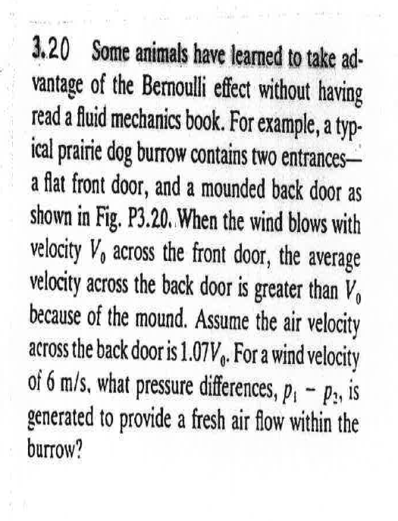
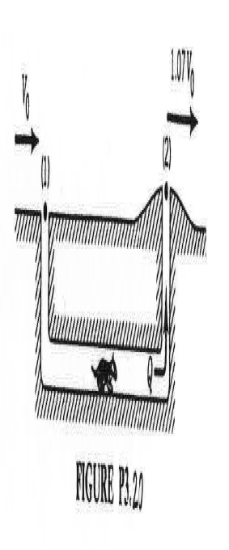
Sample Problem 1

Slide 17
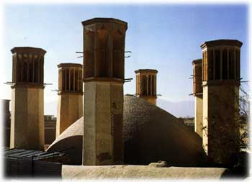
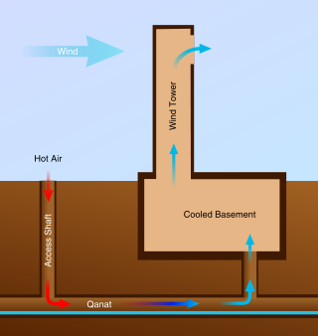
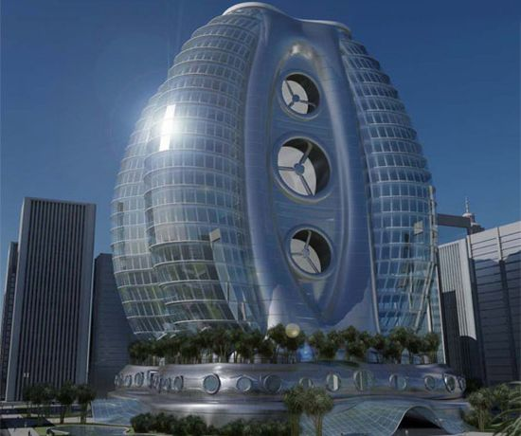
Application - Iranian Wind Towers
http://nd.edu/~bolster/Research%20Highlights.html

Slide 18
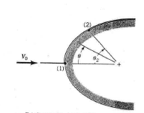
Sample Problem 2
An inviscid fluid flows along the stagnation streamline with starting velocity V₀.
Upon leaving the stagnation point the velocity along the surface of the object is assumed to be 2V0 sin ().
At what angular position should a hole be drilled to give a pressure difference of p₁-p₂=ρV₀²/2?

Slide 19
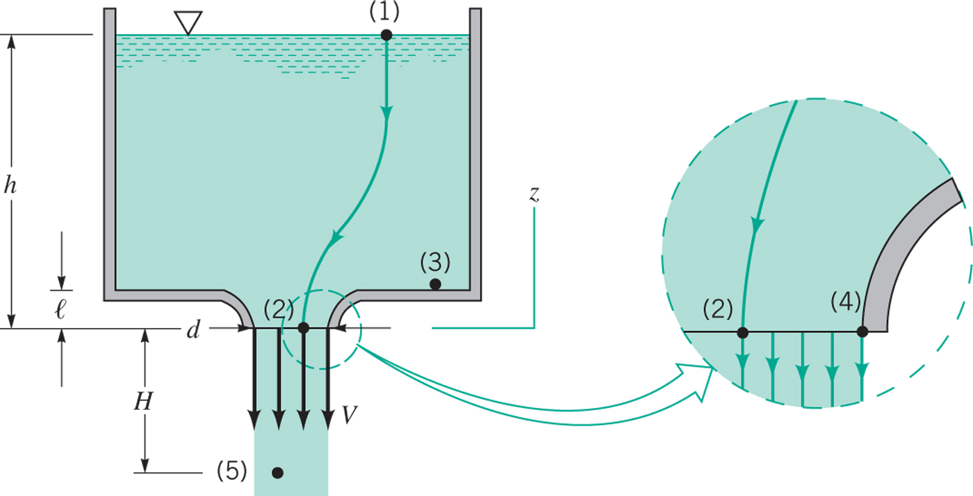
Using the Bernoulli Equation 1 – Free Jet

Slide 20
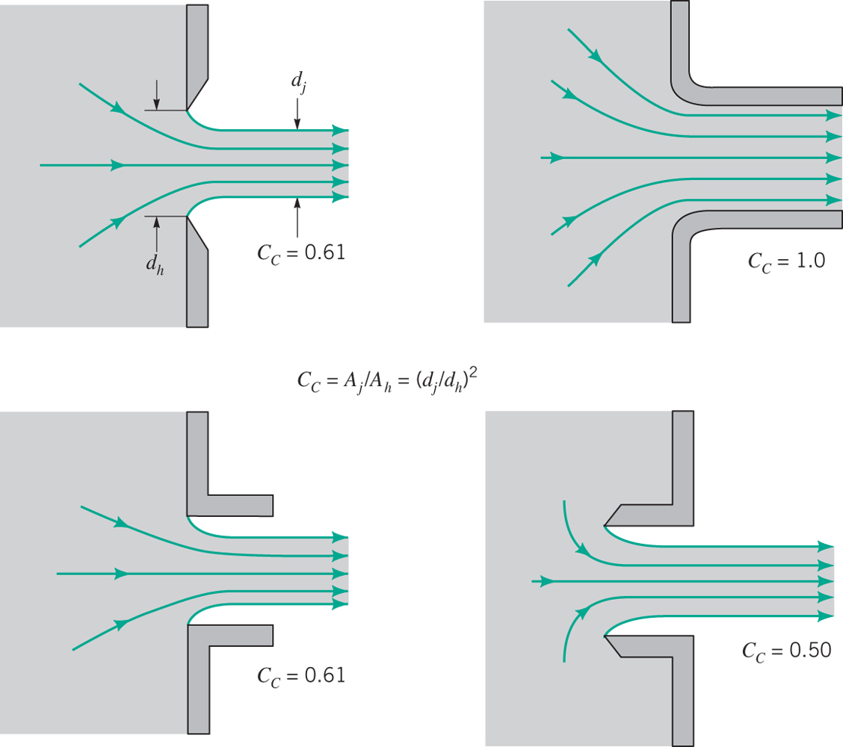
Correction factor – Contraction Coefficient

Slide 21
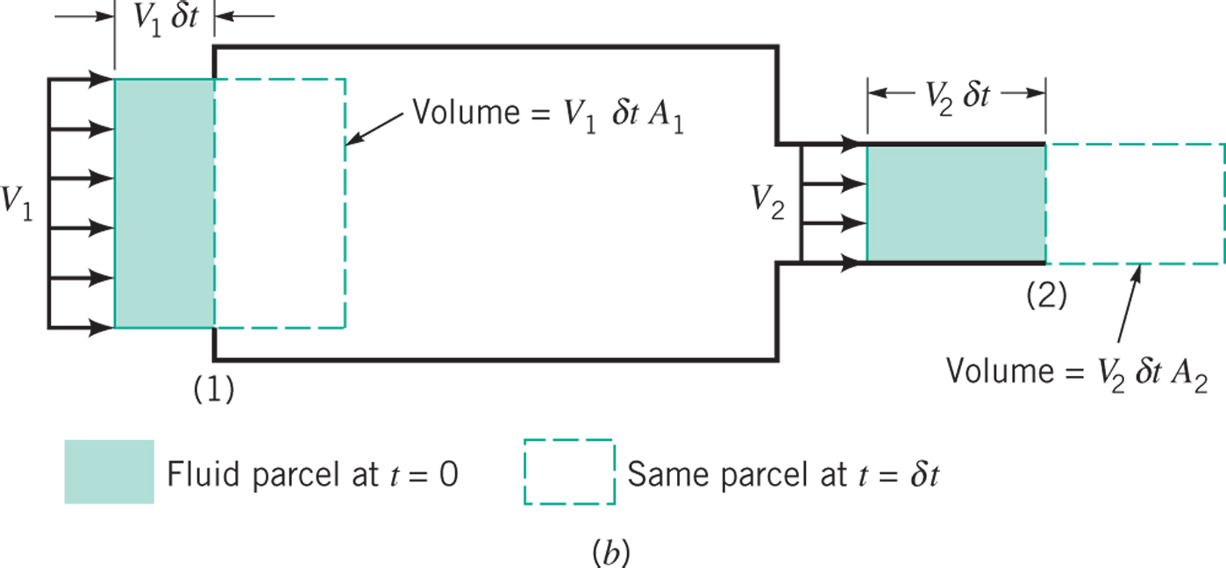
Using the Bernoulli Equation 2 – Confined Flows

Slide 22
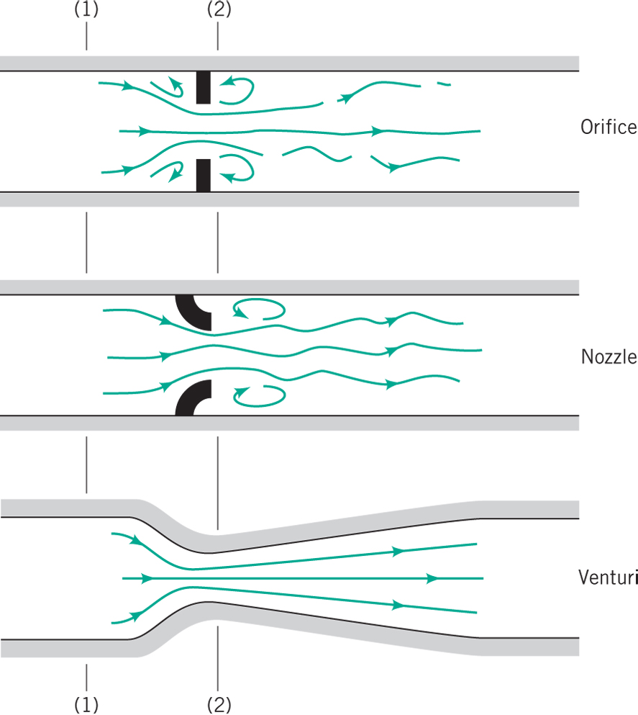
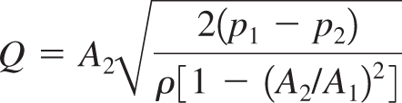
Using the Bernoulli Equation 3 – Flowrate Measurement

Slide 23
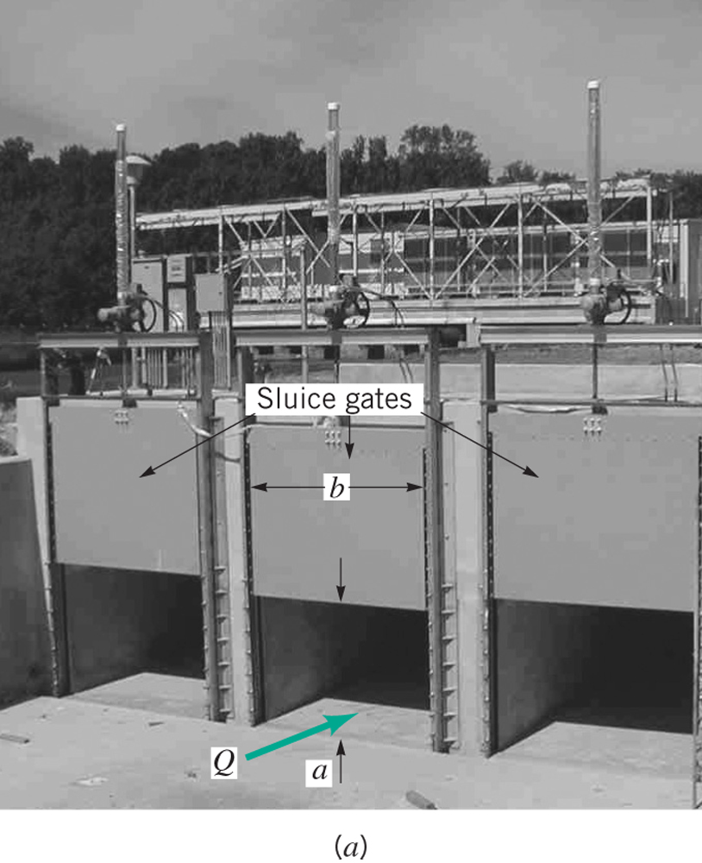
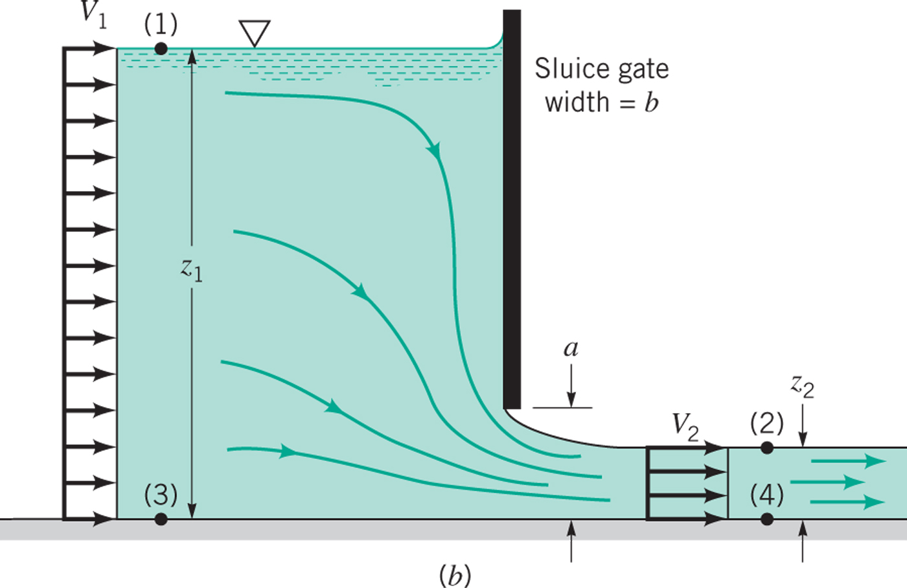
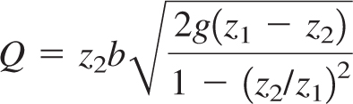
Sluice Gate (Open Channel Flowmeter)

Slide 24
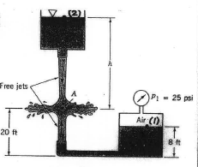
Sample Problem 1
Streams of water from two tanks impinge on one another as shown
Neglect viscosity
Point A is a stagnation point
Determine h

Slide 25
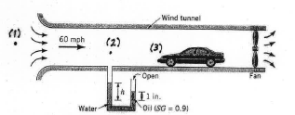
Sample Problem 2
Air is drawn in a wind tunnel for testing cars
Determine the manometer reading h when velocity in test section is 60 mph
Note that there is a 1 inch column of oil on the water
Determine the difference between the stagnation pressure on the front of the automobile and the pressure in the test section

Slide 26
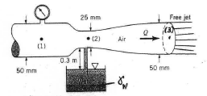
Sample Problem 3
Air flows through this device
If the flow rate is large enough the pressure at the throat is low enough to draw up water. Determine flow rate and pressure needed at Point 1 to draw up water at point 2
Neglect compressibility and viscosity

Slide 27
Restrictions of the Bernoulli Equation
Incompressible
Invisicid (can be corrected for with viscous losses term – see later on in course)
Does not account for mechanical devices (e.g. pumps) – again can be corrected for as above.
Apply along a streamline!

Slide 28


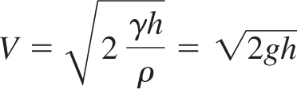
Useful Equations
Streamwise Acceleration
Bernoulli Equation
Pitot Static Tube
Free Jet
Flow Meter
Sluice Gate

